Slide 1
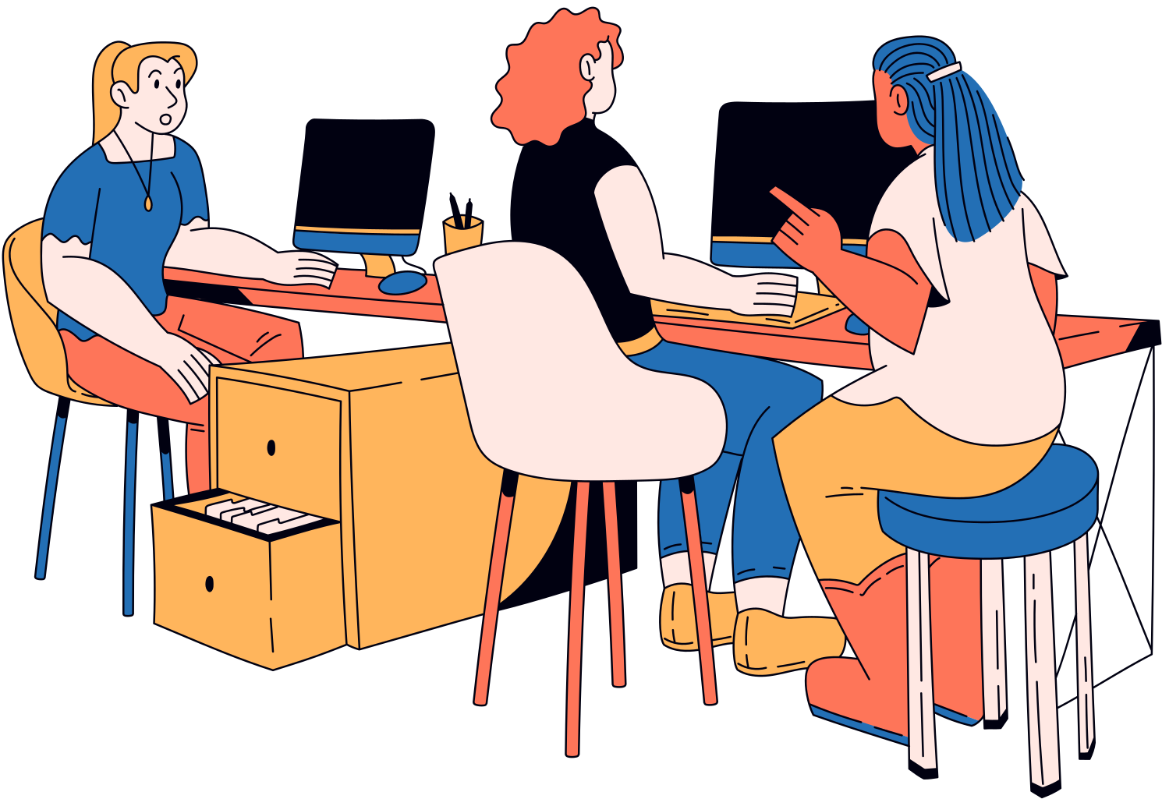
GigBytes
Low-entry, byte-sized gigs
A presentation by Amabella Q. Aguiluz

Slide 2
What about students wanting to earn extra money?
Students have lots of academic responsibilities and cannot commit to a full-time job
Most job posted are for full-time positions or require a degree already
Part-time positions are scarce
Occasional gigs are optimal but difficult to find

Slide 3
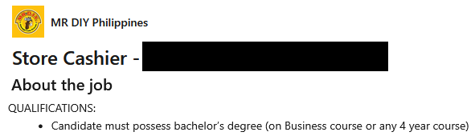

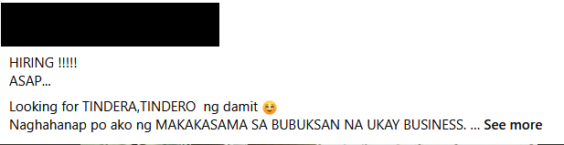
Facebook is prone to spam, job boards have a high entry barrier.

Slide 4
Facebook is prone to scams
The Department of Migrant Workers (DMW) took down over 71,000 fake and illegal job postings on Facebook and TikTok in 2024
DMW removes 71,000 fake job postings on Facebook, TikTok in 2024
Rappler (2025)

Slide 5
Job boards like LinkedIn have a high entry barrier
In a survey in Singapore which polled over 500 HR professionals, recruiters revealed that half or less than half of job applications met their requirements.
Globally, the job hunt has become tougher, with 50% of jobseekers having difficulty finding work in the last year, says LinkedIn.
More competition for roles among graduates, employers flag skills gap: LinkedIn
The Business Times (2025)

Slide 6
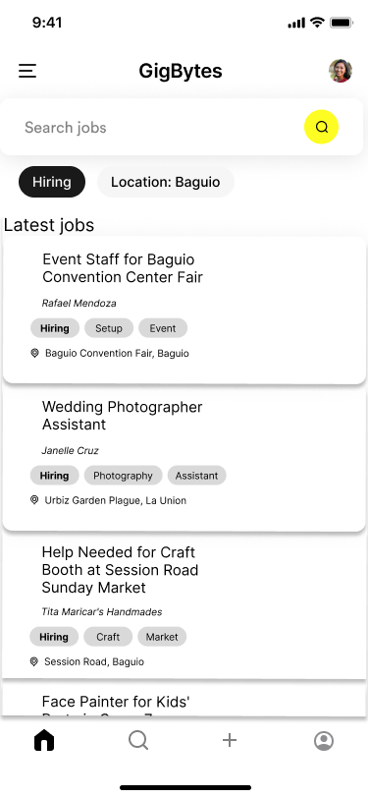
Gigs with low barrier of entry
Local opportunities
Organized tagging system

Slide 7
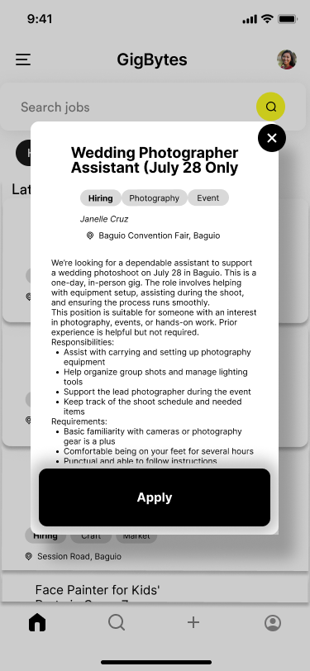
Easy to apply to postings
Local opportunities
Organized tagging system

Slide 8
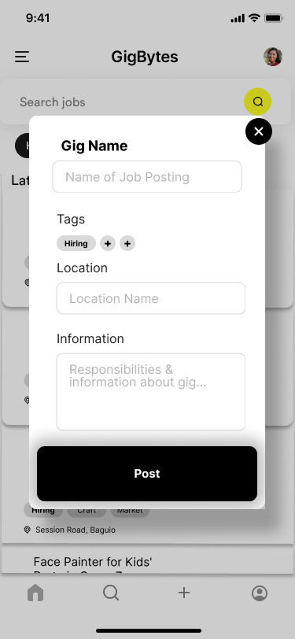
Easy to create postings
Organized tagging system
Easy to post
Easily receive information of applicants

Slide 9
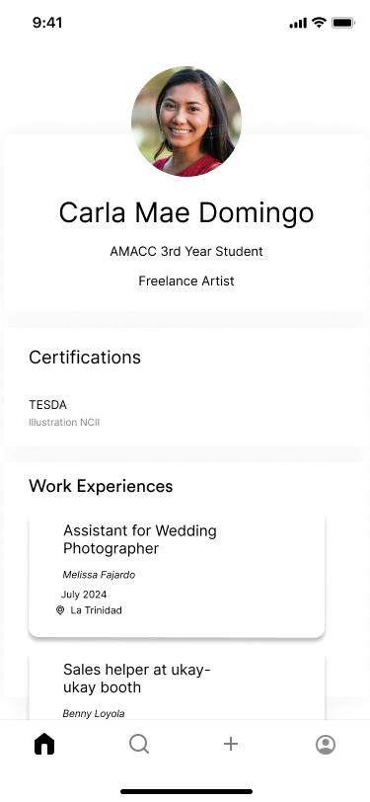
Personal profile system
Showcases certifications and qualifications
Displays previous gigs worked via GigBytes

Slide 10
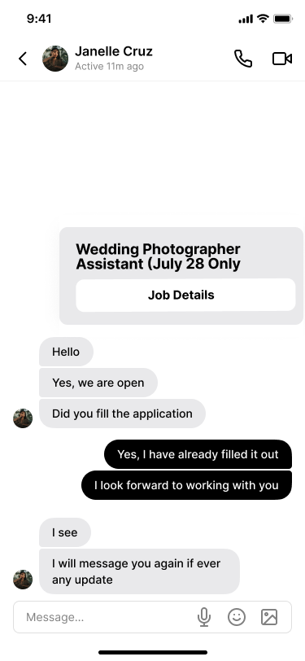
Built-in Messaging System
One-on-one conversations between future colleagues

Slide 11

Not just for students
Everyone is looking for more chances to earn, without committing to a full-time job.
People lacking a degree or work experience.
Part-time workers.
Full-time workers.
Stay-at-home mothers.

Slide 12
Conclusion
GigBytes aims to provide an easy to navigate system to provide accessible opportunities for people to earn extra cash, without a high entry barrier.

Slide 13


GigBytes
thank you!
@reallygreatsite

